Slide 1

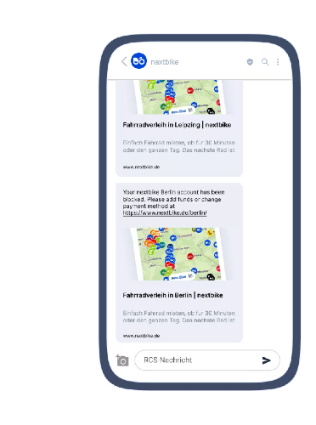


BRANDS: TRANSACTIONAL (nextbike)
DATE
August, 2024
COUNTRIES/ OPERATORS
Germany, all operators
AGGREGATOR
Infobip
PURPOSE
nextbike, Germany’s innovative bike-sharing company, wanted secure and timely delivery of transactional messages, build customer trust and protect against phishing and fraud in a unified platform capable of delivering messages, without disruptions
CALL FOR ACTION
With RCS nextbike send visually rich, interactive transactional messages, enhancing user engagement and security, while SMS served as a fallback option to guarantee uninterrupted service
TARGET USERS
Users of nextbike’s bikes
KPI
By adopting RCS, nextbike reinforced its position as an industry leader, driving customer growth and loyalty through innovative communication solutions. Implementing an omnichannel approach reduced costs, increased brand visibility, and provided a more engaging user experience.
Source: Infobip
1

