Slide 1
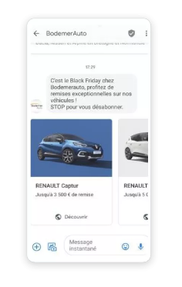
BRANDS: DIRECT MARKETING (Digitaleo)
DATE
2022
COUNTRIES/ OPERATORS
France, all operators
AGGREGATOR
Infobip
PURPOSE
Digitaleo, a marketing agency from France, wanted to make communication campaigns more engaging.
CALL FOR ACTION
Digitaleo suggested RCS Business Messaging to one of their clients, an auto retail company called Bodemer Auto. They immediately saw the benefit of being able to send a carousel of vehicle images to their customers and then follow up with interested customers.
After the initial support from Infobip, the team at Digitaleo took complete control of the solution and quickly started creating campaign scenarios. Together with Bodemer Auto, they decided to target Black Friday as the ideal date to start a conversation.
When the time came, Bodemer Auto’s customers received interactive RCS messages that showcased the vehicles with details on the Black Friday deal, and invited them to the dealerships.
TARGET USERS
Bodomer Auto users
KPI
17 times more engagement with RCS compared to SMS
Adding RCS Business Messaging to their portfolio was a success by itself for Digitaleo, as it gave them the ability to offer their clients an effective 2-way communication channel. However, in order to get the best insight into the effectiveness of RCS, Digitaleo also sent a comparative campaign through SMS.
After analyzing the data, they saw that the RCS campaign for Bodemer Auto had a click rate of almost 8%, while the SMS campaign click rate was less than 1%.
Source: Infobip
1

