Slide 1
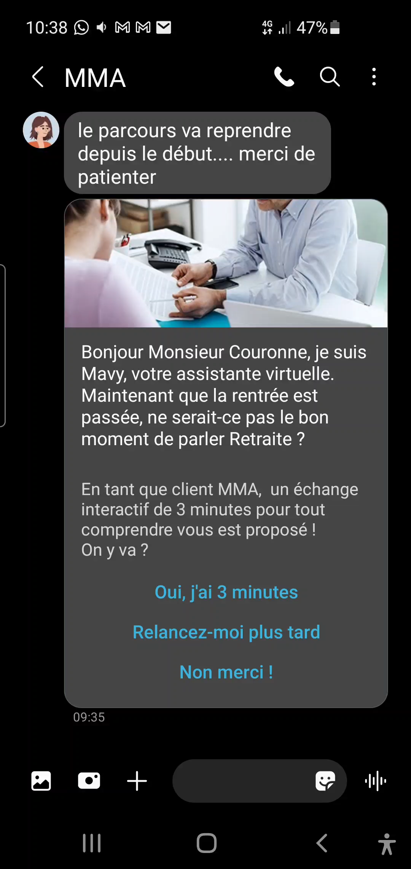



BRANDS: EDUCATIONAL MARKETING (Covea)
DATE
2021
COUNTRIES/ OPERATORS
France, all operators
AGGREGATOR
Infobip
PURPOSE
Move from transactional to conversational communication channels
Make the messaging around their retirement products more attractive to existing and prospective customers
CALL FOR ACTION
The interactive quiz over RCS was setup via our customer engagement solution Moments that triggered the questions based on customer intent and replies.
TARGET USERS
Covea users
KPI
The campaign targeted 15,000 customers, of which 20% were reached via RCS. The omnichannel setup ensured that undelivered RCS messages were sent via SMS, and for customers that didn’t have a mobile number an Email was sent. This ensured high deliverability of messages.
A similar campaign in 2020 over Email resulted in a 44.74% open rate and a conversion rate of only 0.05%. While Email worked well for transactional communications when it comes to lead generation, a conversational experience across the entire customer journey delivered better results.
With an objective of nurturing leads, Life Insurance Department at Covéa Group saw an increased conversion rate via RCS’s conversational experience – with 11% of customers asking for a call back and only one unsubscribe request.
Source: Infobip
1

