Slide 1
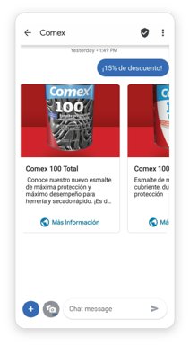
BRANDS: DIRECT MARKETING (ClubComex)
DATE
2021
COUNTRIES/ OPERATORS
Mexico, all operators
AGGREGATOR
Infobip
PURPOSE
Club Comex, one of the largest paint retailers in Mexico faced Low click-through rates and engagement among the existing customer base. They needed a more illustrative messaging channel
CALL FOR ACTION
RBM features like rich messages ensured higher engagement and the ability to track and analyze results in real-time
Images, video, audio and web links elevated user experience
TARGET USERS
Club Comex users
KPI
When delivered via RCS, the first, sales-focused campaign resulted in a revenue increase of 115% over the previous year’s SMS communication. Additionally, click-throughs jumped to 7.9% from less than 3%.
Their second customer-nurturing campaign using the magazine imagery resulted in a click-through rate of 20.6% – approximately ten times more than the campaign average with SMS.
With demonstrated success in increasing both revenue and engagement rates, Club Comex continues to deliver more visually appealing and interactive native mobile messaging campaigns to their members via RCS Business Messaging.
Source: Infobip
1

