Slide 1
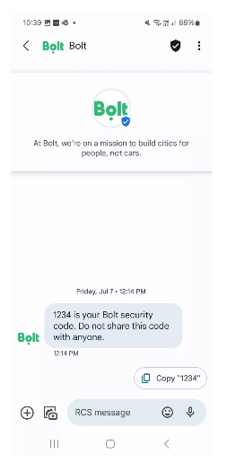
BRANDS: TRANSACTIONAL (Bolt)
DATE
August, 2024
COUNTRIES/ OPERATORS
Germany, all operators
AGGREGATOR
Infobip
PURPOSE
Safety concerns for both drivers and customers increased, highlighting the need for effective security solutions
Sought to enhance security through two-factor authentication (2FA) while providing a frictionless and engaging user experience, moving beyond traditional channel
CALL FOR ACTION
Bolt integrated RCS Business Messaging into its authentication process, providing a branded and engaging experience while using SMS as a backup channel
TARGET USERS
Bolt users
KPI
Enhanced security measures led to increased trust in the Bolt platform, facilitating smoother onboarding and account management
The omnichannel approach of combining RCS and SMS ensured that users received timely and secure communications, improving overall satisfaction and reducing the risk of account-related fraud
Source: Infobip
1

