Slide 1
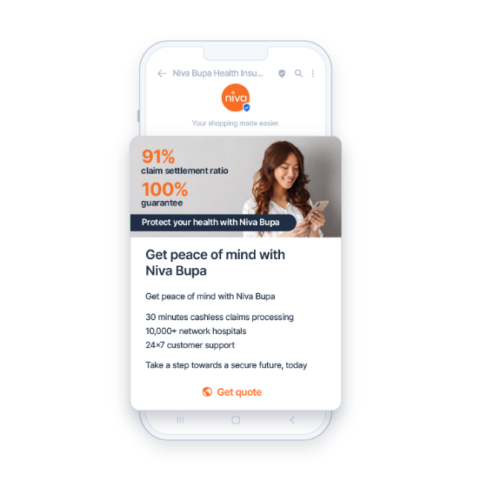
BRANDS: DIRECT MARKETING (Niva Bupa)
DATE
June, 2024
COUNTRIES/ OPERATORS
India, all operators
AGGREGATOR
Infobip
PURPOSE
Niva Bupa needed to explore richer media channels beyond traditional SMS and email to engage today's tech-savvy consumers effectively. Refresh remarketing efforts to improve customer acquisition, retention, and drive repeat business
CALL FOR ACTION
Capture attention by adding RBM features like images, carousels, and videos to messages
Add an extra layer of trust and familiarity to its marketing messages through a conversational approach
TARGET USERS
Niva Bupa users
KPI
Implementing an omnichannel acquisition and remarketing strategy with rich messaging channels led Niva Bupa to its desired results. The insurance company’s customers now open, read, and click-through the messages they receive, resulting in up to 75% return on investment for RCS messages, compared to 60-65% ROI on SMS and WhatsApp messages. This has led to increased CTR by 10%, improved domain reputation, and a deeper understanding of user engagement based on geographical open rates – allowing Niva Bupa to explore the use of multi-lingual communication for even better engagement in specific regions.
Source: Infobip
1

