Slide 1
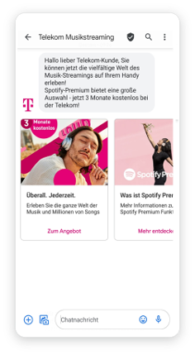
BRANDS: DIRECT MARKETING (Telekom Deutschland)
DATE
August, 2021
COUNTRIES/ OPERATORS
Germany, all operators
AGGREGATOR
Infobip
PURPOSE
Telekom Deutschland, one of the world’s leading integrated telecommunications companies, Wanted to create and execute an exciting campaign that would not only inform their customer base about their latest Spotify Premium offer but also initiate conversion
CALL FOR ACTION
Creating and delivering rich media messages via RCS with the offer and information on data privacy
From the get-go of the RCS campaign, customers were sent an eye-catching message straight into their default messaging app via Moments
Conversations helped unexpected questions be directed to the right agent
TARGET USERS
DT users
KPI
The first campaign launched in August 2021. The results were clear — the RCS messages performed 2X better than the SMS messages in terms of engagement and conversions.
Open rates were sky high. Branding RCS messages with Telekom Deutschland’s name and logo boosted customers’ trust and confidence.
The second campaign began in October. Real-time analytics via our platform enabled Telekom Deutschland to make quick campaign tweaks to the campaign in Moments, resulting in even better performance:
26% higher open rate l 66% higher engagement l 120% higher conversion
Following the successful rollout, Telekom Deutschland began looking to drive a wider adoption of RCS in Germany. Fast forward to 2024, and a crucial decision by Apple to support RCS messaging on its phones is set to turbocharge the use of RCS Business Messaging generally. Businesses will be able to reach a large majority of the population with rich and engaging RCS messages.
Source: Infobip
1

