Slide 1
DCB For Growth Working Group
^{February 19th, 2024}

Slide 2
Anti-Trust Policy
Anti-trust law prohibits agreements (written or implicit) between competitors that may negatively impact consumers or competitors and sharing of confidential information
Anti-trust violations do not require proof of a formal agreement. A violation may be alleged based upon the mere appearance of unlawful activity.
All meeting participants must abide by the following rules:
DO clearly identify the positive purpose of each project and follow it
DO NOT enter into agreements that restrict other parties’ actions
DO NOT give rise to barriers to market entry
DO NOT discuss or exchange specific, confidential or commercially sensitive data on pricing, promotions and business plans
Anti-trust laws do not prohibit petitioning the government, educating and informing the public, improving quality and safety standards, or protecting the public from fraud.

Slide 3
DCB for Growth Working Group
MISSION
Promote Adoption of DCB As a Trusted Payment Method
DELIVERABLES:
Monthly forum for the review and discussions of new industry trends impacting all stakeholders
Creation of best practices, framework and guidelines for optimising Direct Carrier Billing customer experience (the journey from advertising -> payment processing -> service delivery -> customer support) both in terms of value creation, purchase awareness and security
Promotion through whitepapers/reports/infographics/webinars/videos/social media (much of this created by members of this group) to educate the market and stakeholders

Slide 4
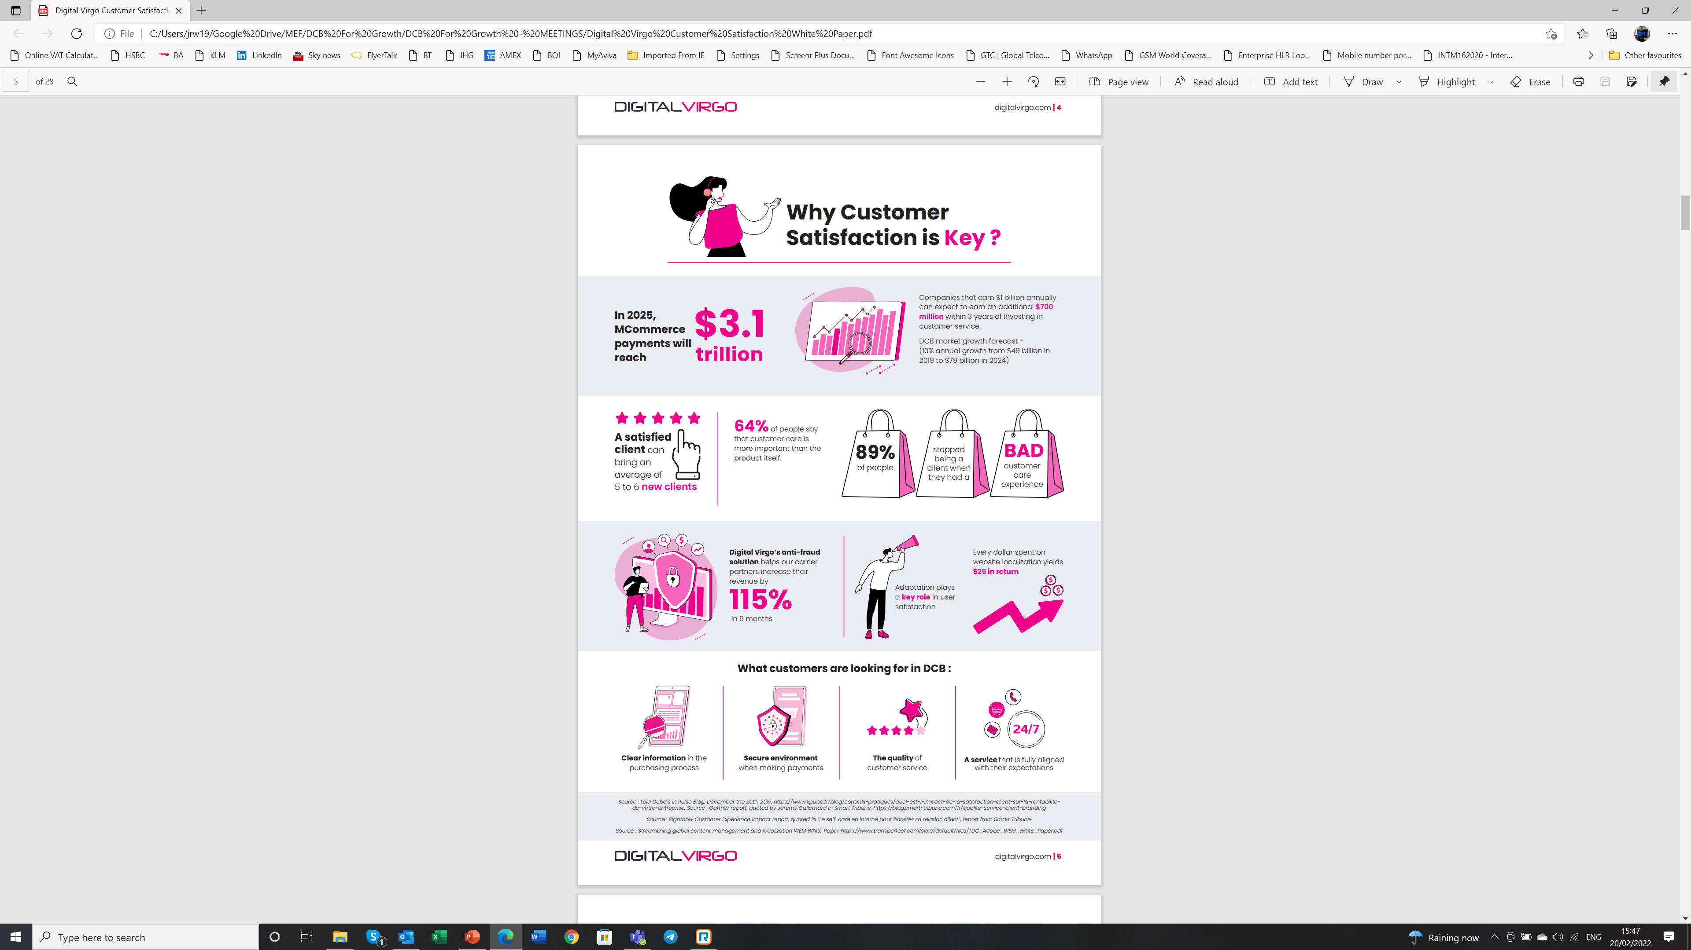
No Need To Reinvent The Wheel – Or Is There?

Slide 5
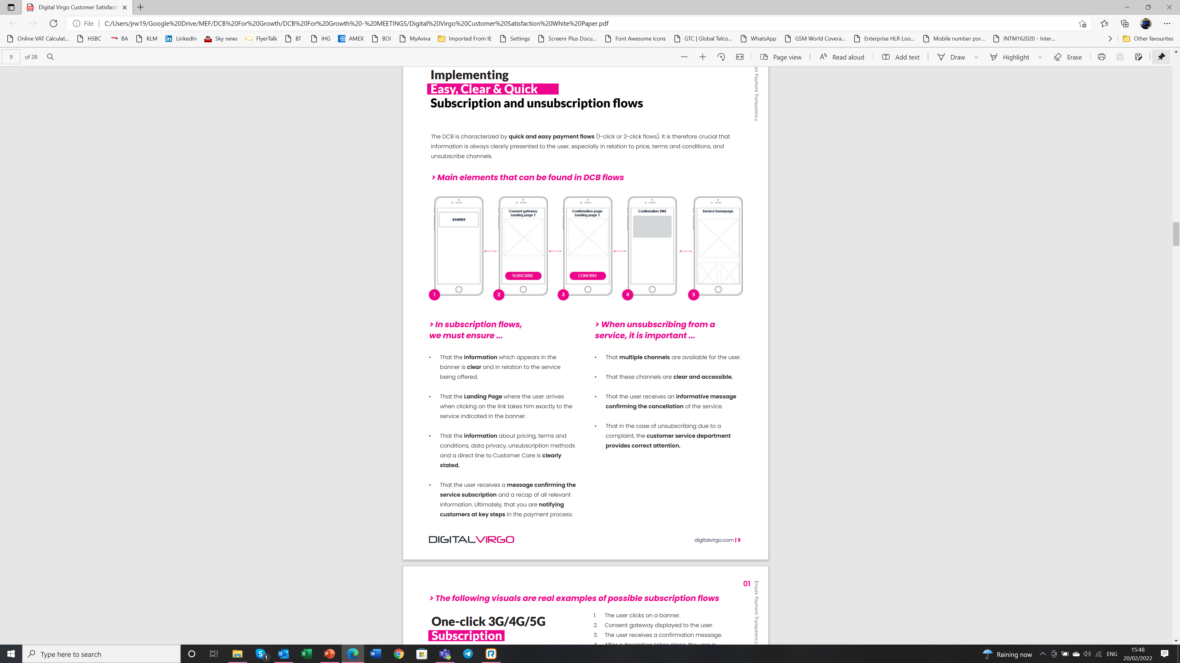
No Need To Reinvent The Wheel – Or Is There?

Slide 6
DCB – Maximising Customer Satisfaction
Here’s the link to a shared document created for our work on this project:
https://docs.google.com/document/d/1Yr6nRAHBjzIlSEPLv_gDNGSOM8pJtpnxalbzqmIQCiM/edit?usp=sharing
What goes on after the initial purchase. Complete protection. Trust around the customer journey. How the end user can understand exactly what they bought. A huge part has got to do with how clients are managed post-purchase. Help the market to grow safely
MEF welcomes contributions from ALL members of this group!

Slide 7
Topics
Panel #1: Ad Fraud & Digital Payments Fraud – Will The Industry Ever Be One Step Ahead Of Bad Actors?
Panel #2: Customer Care & Data – How To Leverage The Data Opportunity
Panel #3: Products – How To Develop & Deliver Products That Surprise & Delight
Panel #4: Compatibility – Can Products Really Meet The Needs Of Every Target Market And Audience?
Panel #5: 5G & Media - Will The Next Big Battle Play Out In Advertising?
Panel #6: Is Advertising-Based Video On Demand (AVOD) The Way to Maintain Market Share?
Panel #7: Convergence Of Telco, Media, Communication, Commerce & Payments - What Will ICT Look Like In 2025?
Panel #8: Customer Data Platforms in Telcos – An Investment Or Cost?
Panel #9: The Emergence of Connected TV & Advertising – TV OEM & Media
Panel #10: Personalization through Monetization & Segmentation – Media + CPG / FMCG?

Slide 8
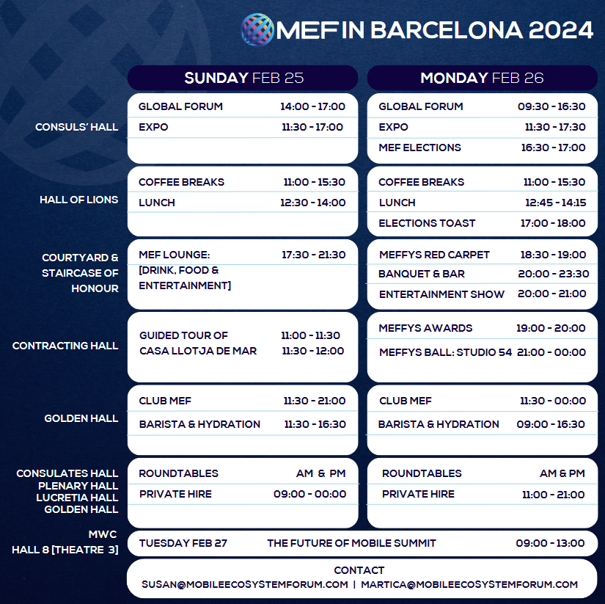
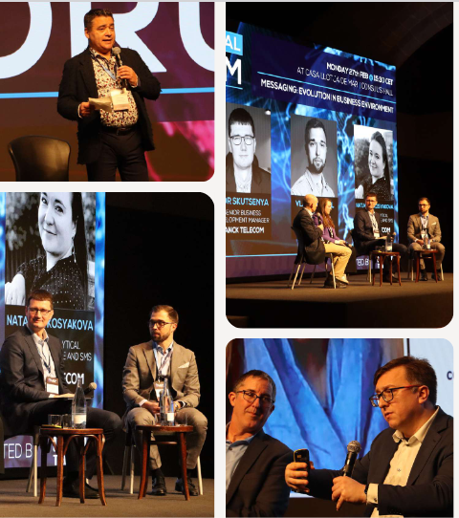
MEF IN BARCELONA

Slide 9
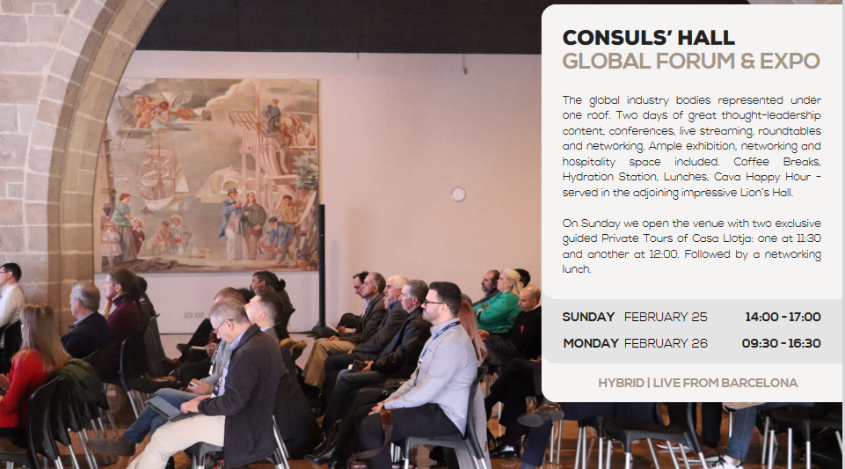
MEF IN BARCELONA

Slide 10
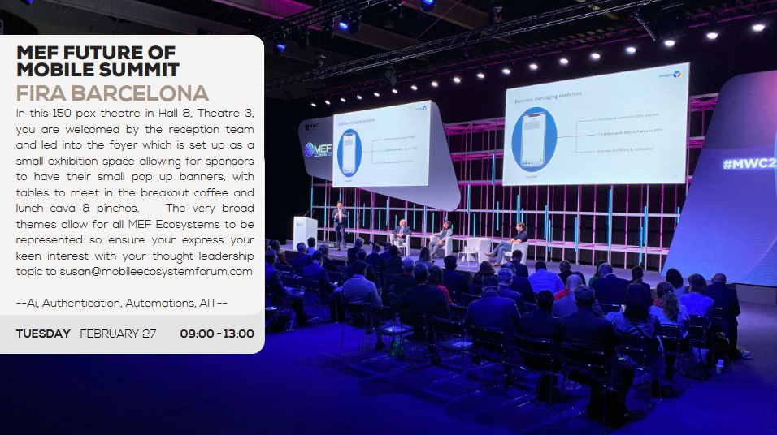
MEF IN BARCELONA

Slide 11
2024 ROADMAP

Slide 12
MEF MEET-UP
MEF CONNECTS
KUALA LUMPUR
MOBILE CONTENT & PAYMENTS
KUALA LUMPUR - MALAYSIA
KUALA LUMPUR - MALAYSIA
MEF CONNECTS
JANUAY
ONLINE
FEBRUARY
25
MEF LOUNGE
GLOBAL FORUM
CLUB MEF + EXPO
25-26
25-26
FEBRUARY
BARCELONA - SPAIN
FEBRUARY
BARCELONA - SPAIN
FEBRUARY
BARCELONA - SPAIN
26
MEF ELECTIONS
26
MEFFYS AWARD SHOW + PARTY
27
MEF @ MWC BARCELONA
THE FUTURE OF MOBILE SUMMIT
FEBRUARY
BARCELONA - SPAIN
FEBRUARY
BARCELONA - SPAIN
FEBRUARY
BARCELONA - SPAIN
19
LEADERSHIP FORUM
19
MEF MEET-UP
MEF CONNECTS
AMERICA
AMERICA
15-16
INDIA
MARCH
MIAMI - USA
MARCH
MIAMI - USA
APRIL
DELHI
24
LEADERSHIP FORUM
7
LEADERSHIP FORUM
7
MEF MEET-UP
BUSINESS MESSAGING
ROME
ITALY
APRIL
DUBLIN
MAY
ROME - ITALY
MAY
ROME - ITALY

Slide 13
MEF FEATURING AT
15
MEF MEET-UP
21
MEF CONNECTS
14-17
ITW
WASHINGTON - ITW
ID & AUTH: PD&I
MAY
WASHINGTON, D.C. - USA
MAY
WASHINGTON, D.C. - USA
MAY
LONDON - UK
MEF FEATURING AT
11
MEF MEET-UP
12
MEF CONNECTS
4-5
MESSAGING & SMS WORLD
STOCKHOLM
NORDICS
JUNE
LONDON - UK
JUNE
STOCKHOLM - SWEDEN
JUNE
STOCKHOLM - SWEDEN
MEF MEET-UP
MEF MEET-UP
16
LEADERSHIP FORUM
16
MEF CONNECTS
17
MEF CONNECTS
CANADA
CANADA
JAKARTA
JULY
TORONTO - CANADA
JULY
TORONTO - CANADA
JULY
JAKARTA - INDONESIA
18
MEF CONNECTS
3
LEADERSHIP FORUM
10
MEF CONNECTS
ASIA
FRAUD
IoT
JULY
JAKARTA - INDONESIA
SEPTEMBER
LONDON - UK
SEPTEMBER
ONLINE
24
LEADERSHIP FORUM
24
MEF MEET-UP
MEF FEATURING AT
LAS VEGAS
USA
9-10
WORLD TELEMEDIA
SEPTEMBER
LAS VEGAS - USA
SEPTEMBER
LAS VEGAS - USA
OCTOBER
MARBELLA - SPAIN
MEF CONNECTS
MEF CONNECTS
27
MEF MEET-UP
12
MEF MEET-UP
9-10
WHOLESALE
LONDON
AFRICA
OCTOBER
ONLINE
NOVEMBER
LONDON - UK
NOVEMBER
CAPE TOWN - SOUTH AFRICA

Slide 14
13
ROUNDTABLE
18
AGM
18
MEF MEET-UP
AFRICA
LONDON
LONDON
NOVEMBER
CAPE TOWN - SOUTH AFRICA
NOVEMBER
LONDON - UK
NOVEMBER
LONDON - UK
MEF CONNECTS
4
MEF MEET-UP
5
LEADERSHIP FORUM
19-20
OMNICHANNEL
PARIS
WHOLESALE EUROPE
NOVEMBER
LONDON - UK
DECEMBER
PARIS - FRANCE
DECEMBER
PARIS - FRANCE

Slide 15
Our Next Meeting
March 18th 2024 @ 3pm UK time

