Slide 1
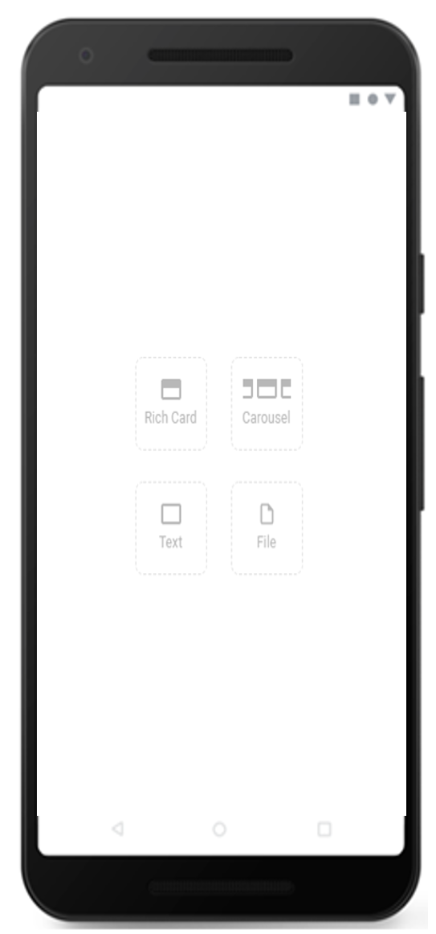
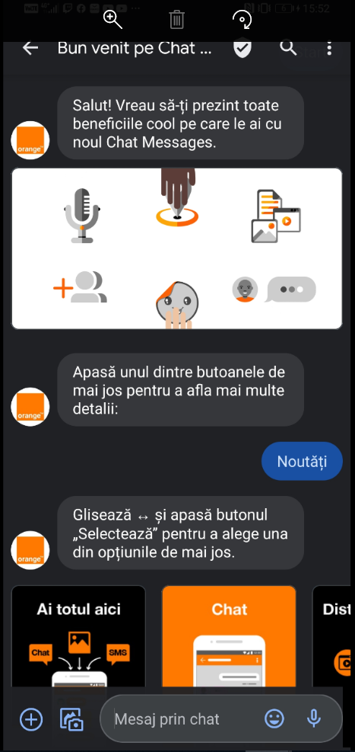
MNO: WELCOME (ORANGE ROMANIA)
DATE
May 2021
COUNTRIES/OPERATORS
Romania, Orange only
AGGREGATOR
N/A
PURPOSE
Educating customers about RCS P2P and A2P messaging including
Google messaging and Samsung messaging experiences
CALL FOR ACTION
Feedback via a survey
TARGET USERS
New RCS customers, on Android Messages and Samsung
KPI
200k messages sent, 80% delivery rate, 55% read rate. Customer feedback was very positive, with
an average score of 4.1 out of 5 stars (NPS of 33)
RCS BOT RATING
Source: Orange
1

