Slide 1
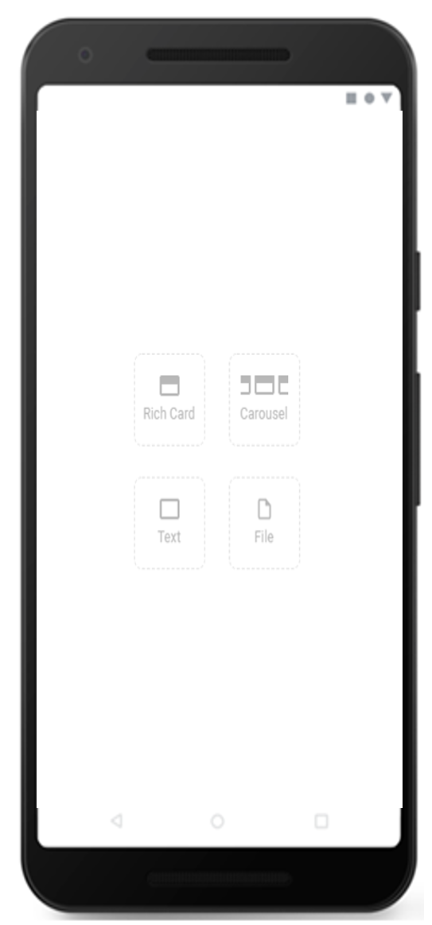
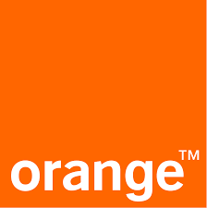
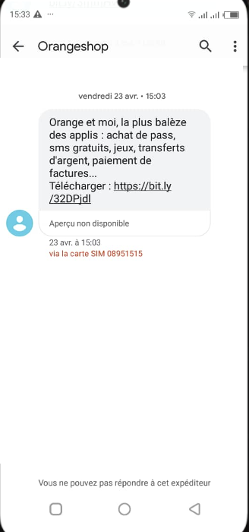
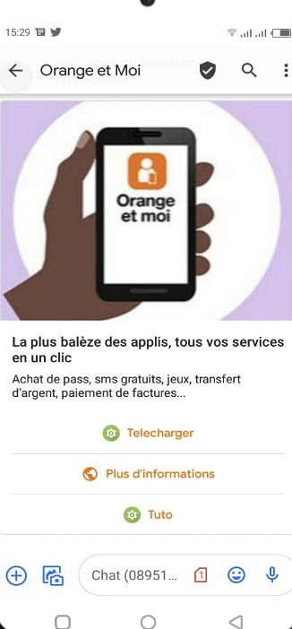
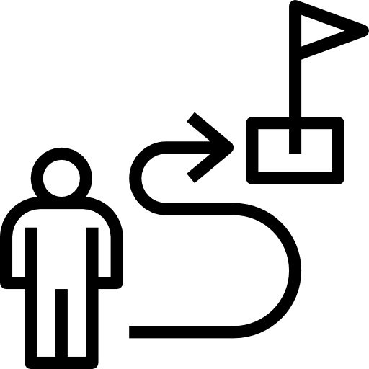
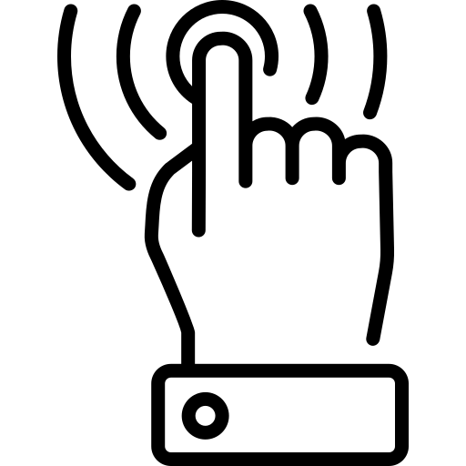
MNO: DIRECT MARKETING (ORANGE IVORY COAST)
DATE
March 2021 (tbc).
COUNTRIES/ OPERATORS
Ivory Cost, Orange only
AGGREGATOR
N/A
PURPOSE
Push customers to download Orange’s
self-care app (MyOrange).
CALL FOR ACTION
Download the MyOrange app.
TARGET USERS
RCS customers without the MyOrange app.
KPI
With RCS, 6% of customers downloaded the MyOrange app, 15 times higher than with SMS.
SMS
RCS
Source: Orange

