Slide 1
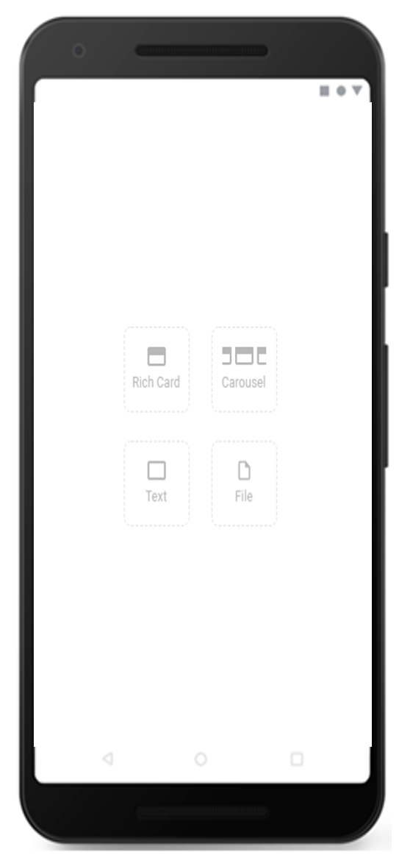
BRANDS: INFORMATION (BRAZILIAN MINISTRY OF HEALTH)
DATE
April 2020
COUNTRIES/ OPERATORS
Brazil, Vivo only
AGGREGATOR
Telefonica Global Solutions
PURPOSE
The objective of this initiative was to enable Vivo to offer its users information and recommendations about
coronavirus from official sources, providing a vital resource in Brazil, a country that has had the highest number of
confirmed cases of COVID-19 in Latin America.
CALL FOR ACTION
The campaign delivers an RCS experience for users by displaying a carousel of relevant services to equip them
with the information they need to stay safe and well during the pandemic:
Official online information about COVID-19 and preventive actions to take provided by the Brazilian Ministry of
Public Health.
Direct access to Coronavirus SUS: a public app with general information provided by the National Government
related to the pandemic.
New Vivo services to enable subscribers to remotely manage tasks from home, including working from home,
solving doubts through WhatsApp using Artificial Intelligence from Telefónica’s Aura platform.
TARGET USERS
Initial customer base of 9 million RCS Vivo handsets
KPI
Prepaid. One-shot campaign
4,03M Sent
94% Messages delivered
36% Read rate
SENT | DELIVERED | READ
4.03M | 94% | 36%
Source: Telefonica Global Solutions
1
1

